Slide 1


Wildfire Preparedness
Staff & Parent Presentation
September 20, 2023 (Ormondale)
November 15, 2023 (virtual)
Kim Giuliacci, WFPD Fire Inspector II/ Fire Investigator/ Plans Examiner (Fire Marshal)
Selena Brown, WFPD Public Education Officer/ Emergency Preparedness Coordinator
Roberta Zarea, PVSD Superintendent
Notes:
Roberta

Slide 2
Presentation Agenda
SMCOE Big 5 Immediate Action Response Protocols (Evacuation))
PVSD Wildfire Emergency Response Plan
Emergency Parent Information
Student Release Process
Communication and Maintaining Situational Awareness
Poor Air Quality Protocol
Discussion
Notes:
Roberta

Slide 3
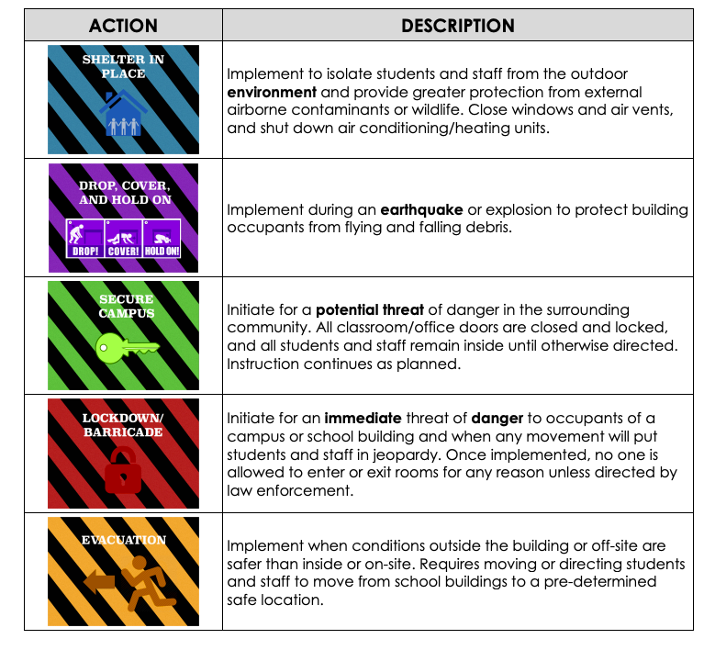

Immediate Action Response: The Big 5 Protocol
Possible Action During Wildfire
Big 5 Community Packet
Notes:
Roberta

Slide 4
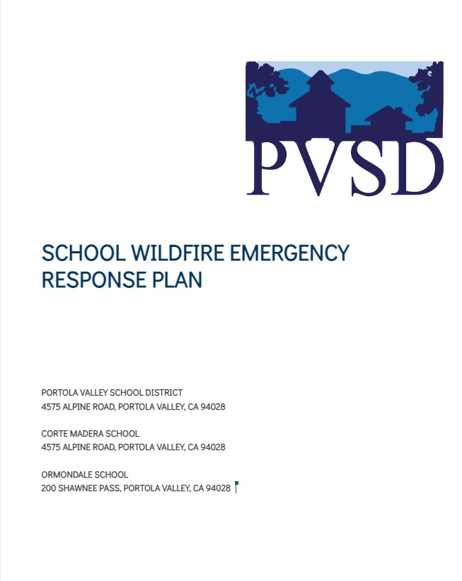
PVSD Wildfire Emergency Response Plan
The purpose of this plan is to provide for the orderly and coordinated evacuation of PVSD facilities once it is determined that such action is the most effective means available for protecting students and staff from the effects of an emergency situation.
WILDFIRE EMERGENCY GUIDANCE TABLE
WILDFIRE EMERGENCY DECISION TREE
CAMPUS OVERVIEW AND MAPS
SCHOOL OVERVIEW
TRANSPORTATION OVERVIEW
OFF SITE EMERGENCY EVACUATION PLAN
CONTROLLED DISMISSAL & REUNIFICATION PLAN
SHELTER-IN-PLACE PROCEDURES
SITUATIONAL AWARENESS RESOURCES
EMERGENCY COMMUNICATIONS PLAN
EMERGENCY CONTACT LIST
Internal Document; Revision in Process
Notes:
Roberta

Slide 5
Evacuation Terminology
In an emergency, local officials may issue either an evacuation warning or an evacuation order.
Evacuation warning:
Alerts people in an affected area of potential threat to life and property.
Considers the probability that an area will be affected within a given timeframe, and prepares people for a potential evacuation order.
Is particularly necessary when dealing with a variety of issues such as large school populations.
In a fast-moving fire there may not be time for first responders to issue an evacuation warning (prepare to evacuate).
Evacuation order:
Requires immediate movement of people out of an affected area due to an imminent threat to life.
Notes:
Kim and/or Selena

Slide 6
Shelter in Place (During Fast Approaching Wildfire)
Sheltering in place is an emergency-driven alternative which is seldom under the best of circumstances, but must be considered when evacuation of the site is not an option.
This may be the most appropriate protective action during a fast moving, approaching wildfire, when leaving school grounds poses more of a danger than remaining in place.
When an evacuation may put students and staff at greater risk, it may be necessary to shelter-in-place.
Designated Shelter in Place locations at each school are the Multi-Use Rooms.
Notes:
Kim/Selena
Under the best circumstances, sheltering‐in-place should be considered when one or more buildings on campus is designed to withstand heat and flames from an approaching wildfire. In other words, these buildings must be built with ignition-resistant construction, including well maintained defensible space, such as fire-resistant landscaping, with a minimum 100‐foot defensible space surrounding the structure(s). Woodside Fire Protection District has assisted in evaluating our defensible spaces, ignition-resistant construction, and fire mitigation efforts.

Slide 7
Voluntary Evacuation/Unplanned Dismissal/ Precautionary Closure
To best ensure the safety of staff and students, school administrators will work in conjunction with local fire and law enforcement to evaluate situations that arise relative to a school site’s unique characteristics, such as facility construction, transportation dependencies, ingress and egress options and capacity, level of defensible space around its structures, and surrounding topography.
Depending on the circumstances, it may be best to issue an early dismissal and voluntarily evacuation.
The decision to close schools is based on many considerations, the most important of which is the safety of students, staff, parents, and others in the community. (See Decision Tree - slide 16)
Notes:
Roberta

Slide 8
Transportation & Off-Site Evacuation
The District works continually with the Town of Portola Valley, the San Mateo County Department of Emergency Management (DEM), and Woodside Fire (WFPD) to explore options to set up transportation and establish off-site assembly locations in an emergency situation.
Transportation options for all students/staff are dependent upon the situation.
Off-site assembly locations are dependent on the situation.
Notes:
What scenarios will district reach out to access buses, what window of time?
How will this be communicated?
Possible emergency transportation resources (buses would need to come to the schools as we don’t own buses):
Las Lomitas Elementary School District
Sequoia Union High School District
SamTrans

Slide 9
Standard Reunification Method (SRM) Information for Parents
The SRM reunification process that will be utilized by the PVSD is:
Notification: parents will receive a phone or text message. “Due to XXX, the school has closed, please pick up your child at XXX location. Bring your ID.”
Parent/guardian Expectations:
Bring identification
Be patient
Notes:
Roberta
Circumstances may occur at the school which require parents to pick up their students in a formalized, controlled release.
This process is called a Reunification and may be necessary due to weather, a power outage, hazmat, an approaching wildfire, or if any crisis situation occurs at the school.
Because a reunification is not a typical end-of-school-day event, reunification may occur at a different location than the school a student attends.
If this location is another school, those students may be subject to a controlled release as well.

Slide 10
Standard Reunification Method Info for Parents
Students will only be released to individuals previously identified as a student’s emergency contact (per PowerSchool Annual Update). When a parent cannot immediately go to the reunification site, the school staff will hold students until parents (or designated individuals) can pick up their student.
For students, the school asks that students be orderly and quiet while waiting.
Cell Phones: Keeping the cellular network usage at a minimum may be important during a reunification. Students are asked NOT to send text messages either in or out of the school or reunification area. Rarely, students may be asked to text a message to their parents or guardians
Notes:
Roberta

Slide 11
SRM Student Release Process for Parents
Go to Reunification “Check In” area and form lines based on the first letter of student’s last name.
While in line, fill out a reunification card. (This card will be provided at the time. It is perforated and will be separated during the process. Some of the same information is repeated on both the top and separated bottom of the card.) Parents are asked to complete all parts of the card. In the case of multiple students being reunified, a separate card for each student needs to be completed.
During check in, picture identification will be verified. The card will be separated and the bottom half given back to the parent.
Go to “Reunification” area: a runner will take the bottom half of the card and take it to the Student Assembly Area to recover the student or students.
Notes:
Roberta

Slide 12
PVSD’s Risk Reduction and Decision Tree

Slide 13
Wildfire Risk Reduction in PVSD
The buildings at each site are generally protected from wildfire risk and are locations for shelter in place protocol:
Ormondale and Corte Madera modernized buildings consist of fiber cement siding and fiber cement panels with gypsum sheathing, which are non-combustible.
Ventilation systems are equipped with screen mesh that reduce the possibility of embers entering combustible spaces. Vents can be closed remotely to prevent outside air from entering the building. The systems are also tied into the fire alarm/notification system.
Roofing at each site are adequately rated roofing systems by the National Fire Protection Agency (NFPA) and UL (Underwriters Laboratories).
New buildings are fully compliant with building code Chapter 7A (formerly called the “Wildland/Urban Interface”), which is intended to govern high-fire-danger areas. Building materials are non-combustible except as noted by code 7A. The majority of visible wood is fire-resistance treated, the siding is non-combustible, the roofs are non-combustible, gutters and attic vents are protected as required, and the glass is tempered as required. The buildings were not intended to be shelters such as essential services buildings, but they are designed to resist ignition and propagation as code requires.
Notes:
Roberta

Slide 14
Wildfire Risk Reduction in PVSD
Defensible space surrounds each of the campuses, and the District continues to clear unnecessary/unwanted vegetation throughout the campuses.
The District will continue to repair damaged vent screens and add screens as necessary, repair damaged siding and roofing as well as keep brush and unwanted vegetation to a minimum throughout the campuses.
The District has hired an arborist to do a risk assessment report on trees at Corte Madera and Ormondale.
Notes:
Roberta

Slide 15
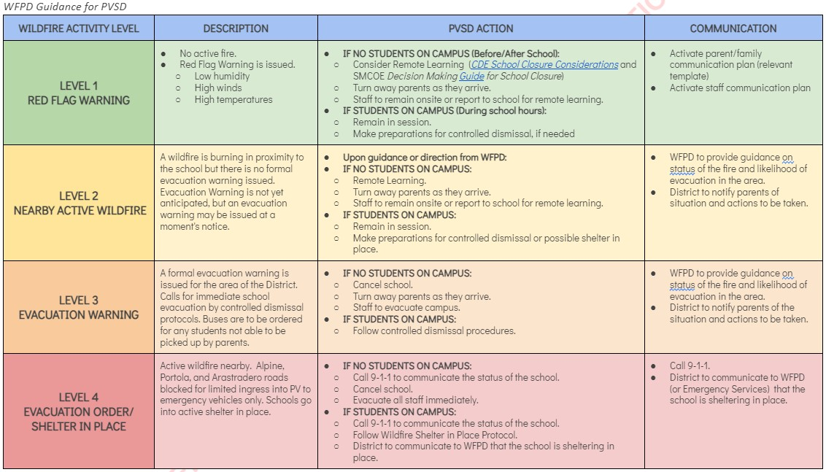
PVSD Wildfire Emergency Guidance Table
Notes:
Kim/Selena

Slide 16
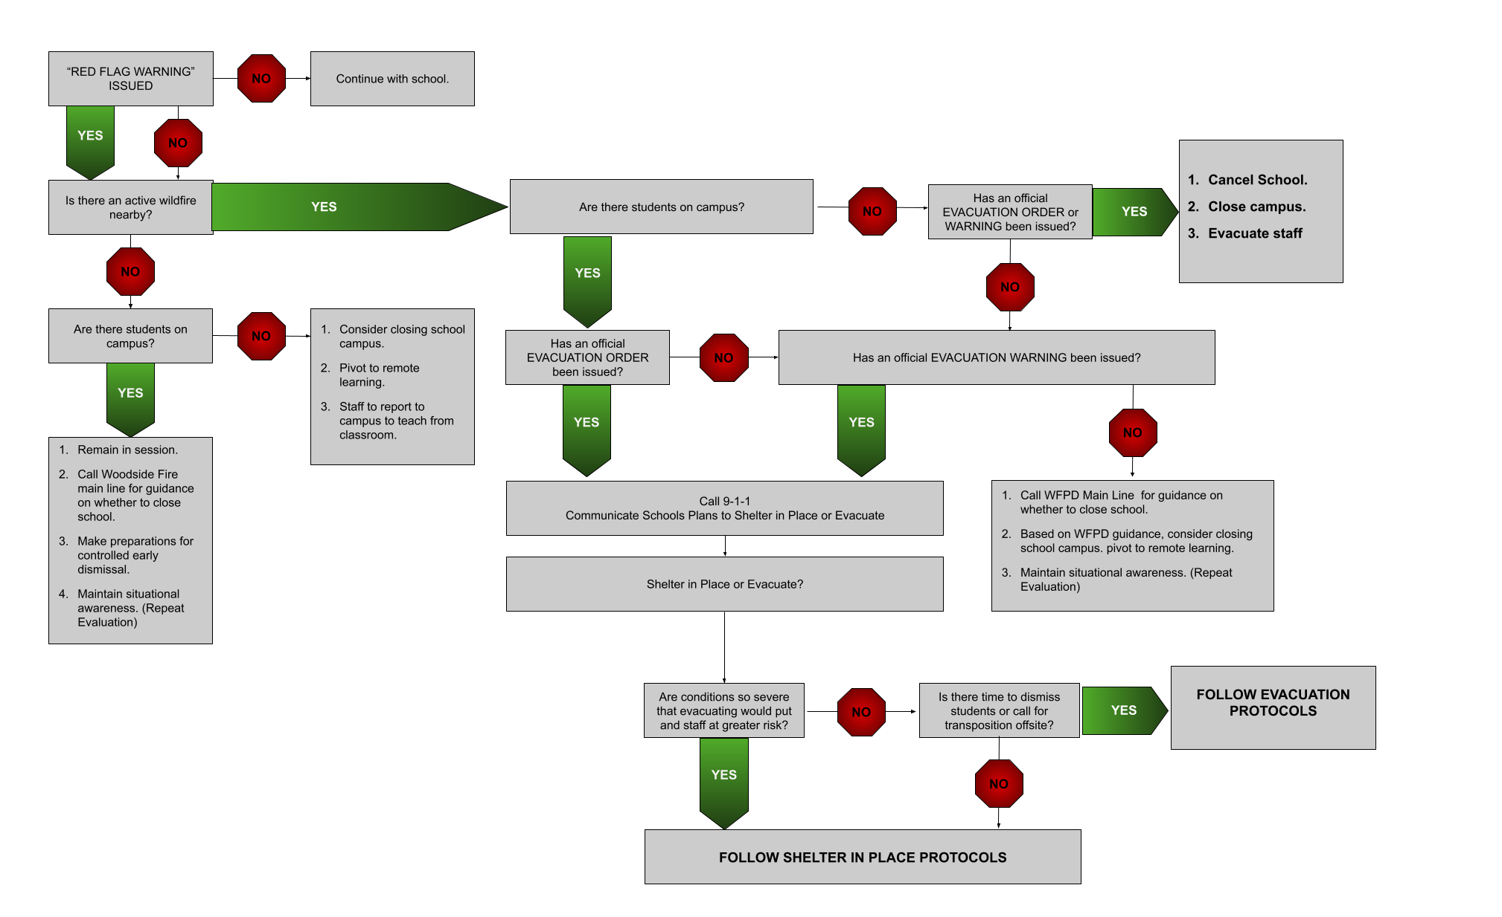
Wildfire Emergency Decision Support Tree
Notes:
Roberta, Kim/Selena

Slide 17
Communication and
Situational Awareness

Slide 18








Maintaining Situational Awareness
Portola Valley Radio 1680 AM
Tune to radio or stream via internet
Notes:
Selena

Slide 19
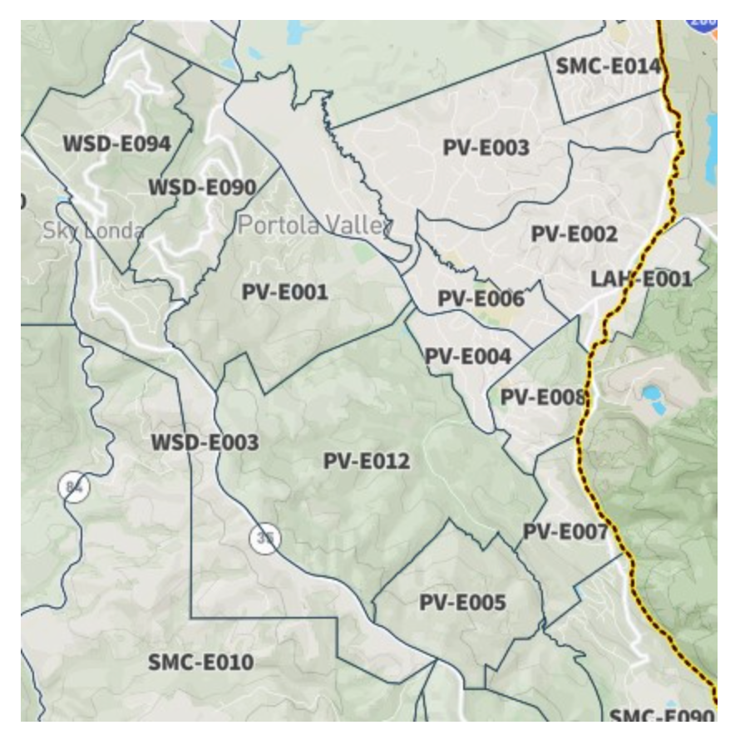


Zone Haven & SMC Alerts & Genasys
Evacuation notices are issued through SMC Alert
Genasys Protect: uses your location on the website and in the app to offer you the most relevant information in an emergency situation (replaces ZoneHaven). Download the app on your iphone NOW!
Notes:
Selena

Slide 20
Emergency Communications and Maintaining Situational Awareness
Internal (within District):
Public Announcement system*
Cell and texting
Fire Alarm System All Call
Two-way radios (walkie-talkies) for each classroom
Shortwave radios
Landline telephones
Satellite radio adapter for cell phones and Government Emergency Telecommunications Service (GETS)
* only if there is electrical power
External (District to parents):
Parent Square Urgent Alert text, email, voice mail - pulls info from PowerSchool
PVSD website
Social Media (Instagram, Facebook)
PV Forum and PV NextDoor
Town of PV Radio 1680
SM County Office of Education website
Portola Valley Town website
SMC Alert
Town of PV radio communication EPC
Notes:
Roberta

Slide 21

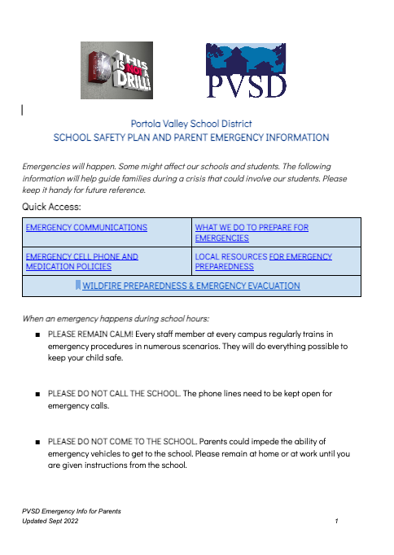
Emergency Parent Information
Link to School Safety Plan and Parent Emergency Information (Scan QR Code for Access)
Located on PVSD website (pvsd.net) homepage
Notes:
Roberta

Slide 22
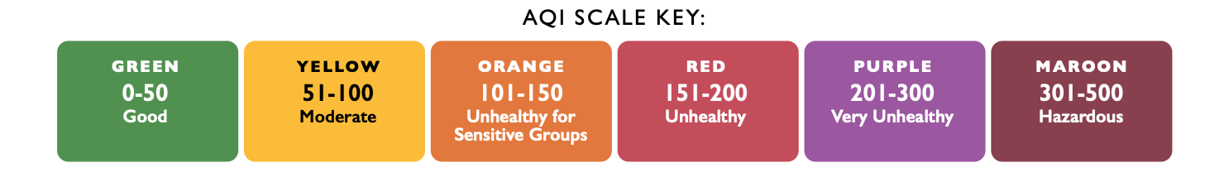
Poor Air Quality

Slide 23
Poor Air Quality: PVSD adheres to SMCOE’s Guidelines
Keep Track of Air Quality: SMCOE and the San Mateo County Health Department use official BAAQMD and AirNow sites to track data and make decisions.
Adjust Activity Based on Air Quality
School Air Quality Activity Recommendations (see Slide 24): how PVSD addresses differing levels of air quality.
Sensitive Groups: Children with certain medical conditions may be impacted by air quality in the moderate (yellow – 51-100) and unhealthy for sensitive groups (orange – 101-150) levels. Parents/guardians of these children should notify their schools.
School Response: When air quality dips to unhealthy levels (red – 151-200), PVSD practices the Big Five Shelter in Place protocol (keeping all activities indoors, limiting physical activity, and minimizing the opening and closing of doors), and continue regular classroom instruction.
Schools are the best place for students to be when air quality is poor as they are well supervised, can be kept indoors, and are able to continue to learn.
If air quality becomes hazardous (maroon – 301-500) and schools do not have the ability to keep outdoor air from easily entering the school,then a school may decide to close.
Notes:
Roberta

Slide 24
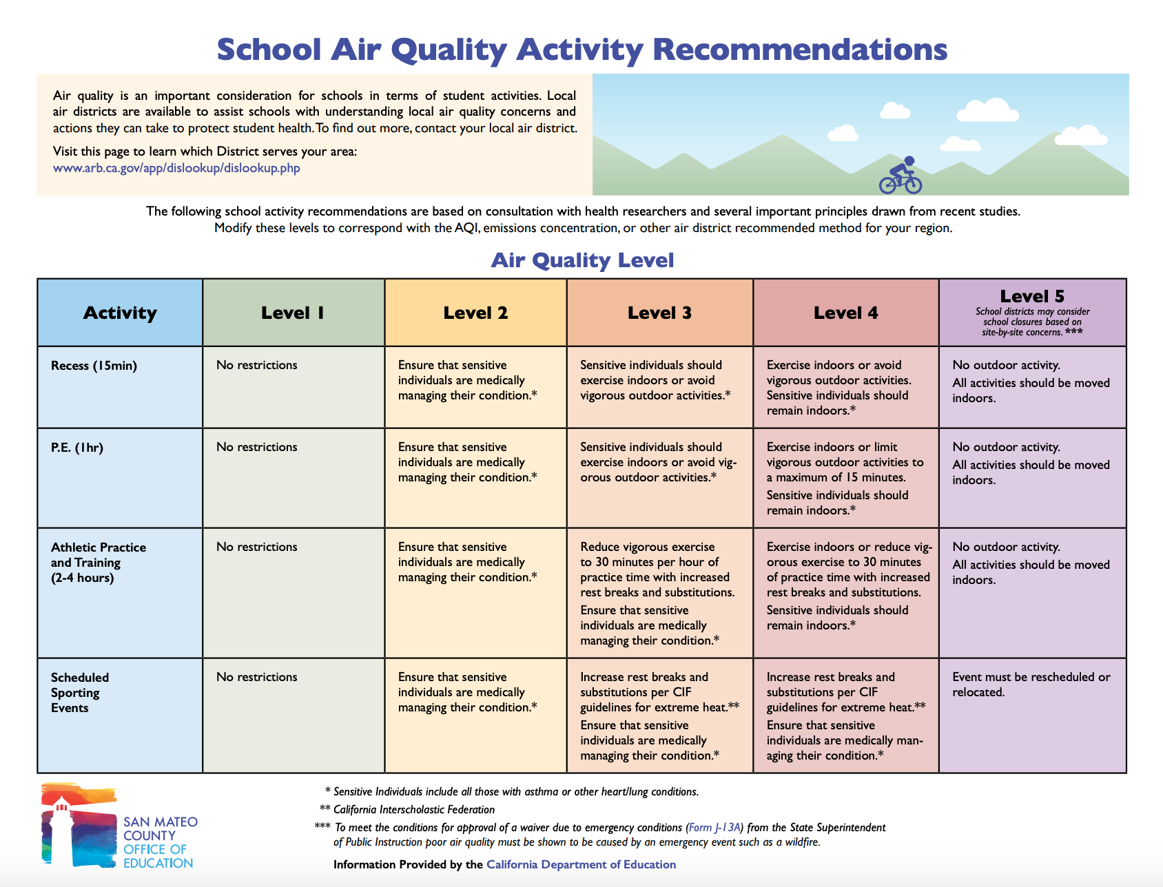
Notes:
Roberta

Slide 25
Discussion

